Slide 2
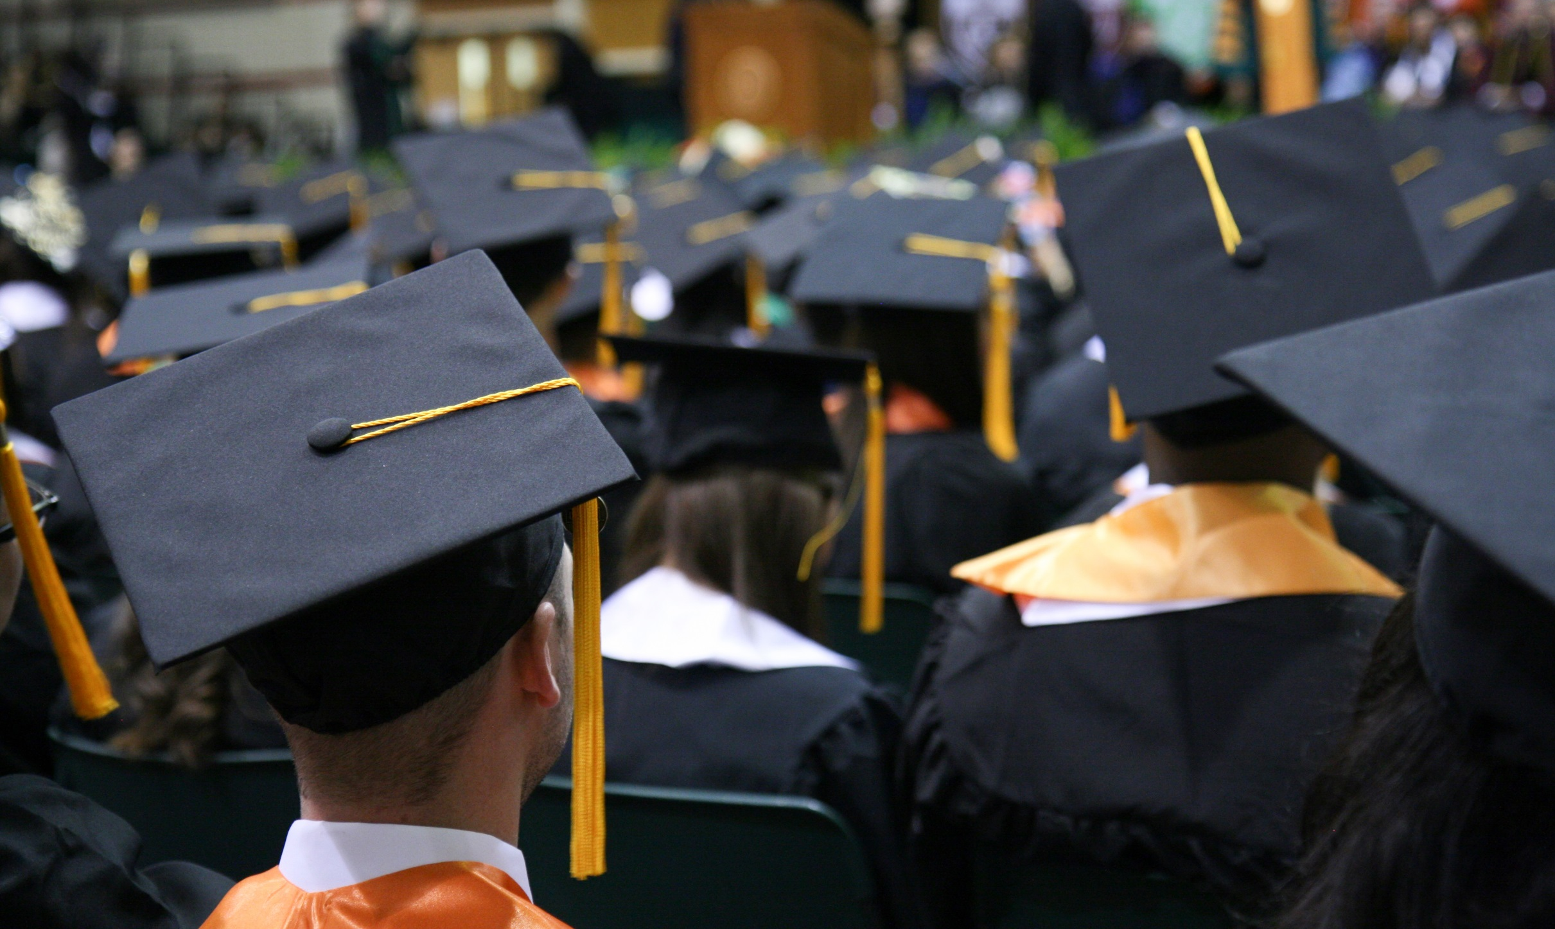
WELCOME TO
GRAD FAIR

Slide 3
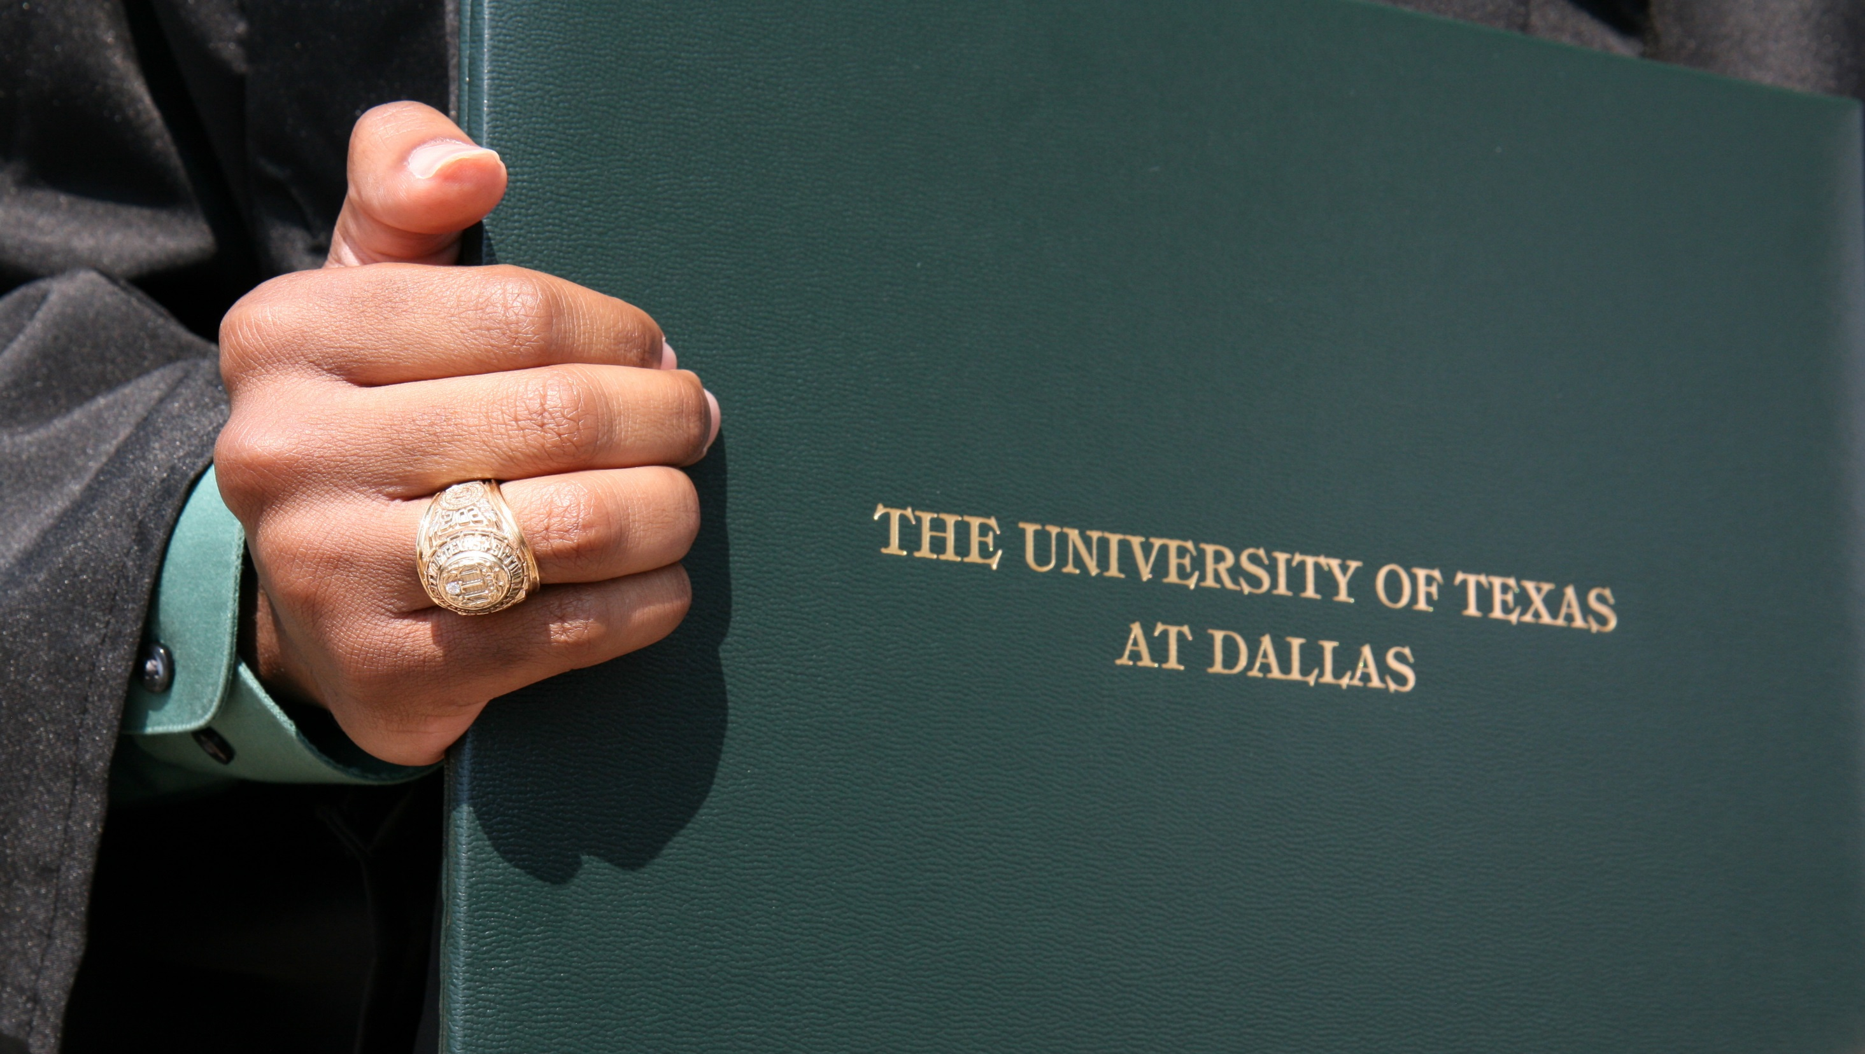
UT DALLAS
RING DAYS
February 27-28

Slide 4
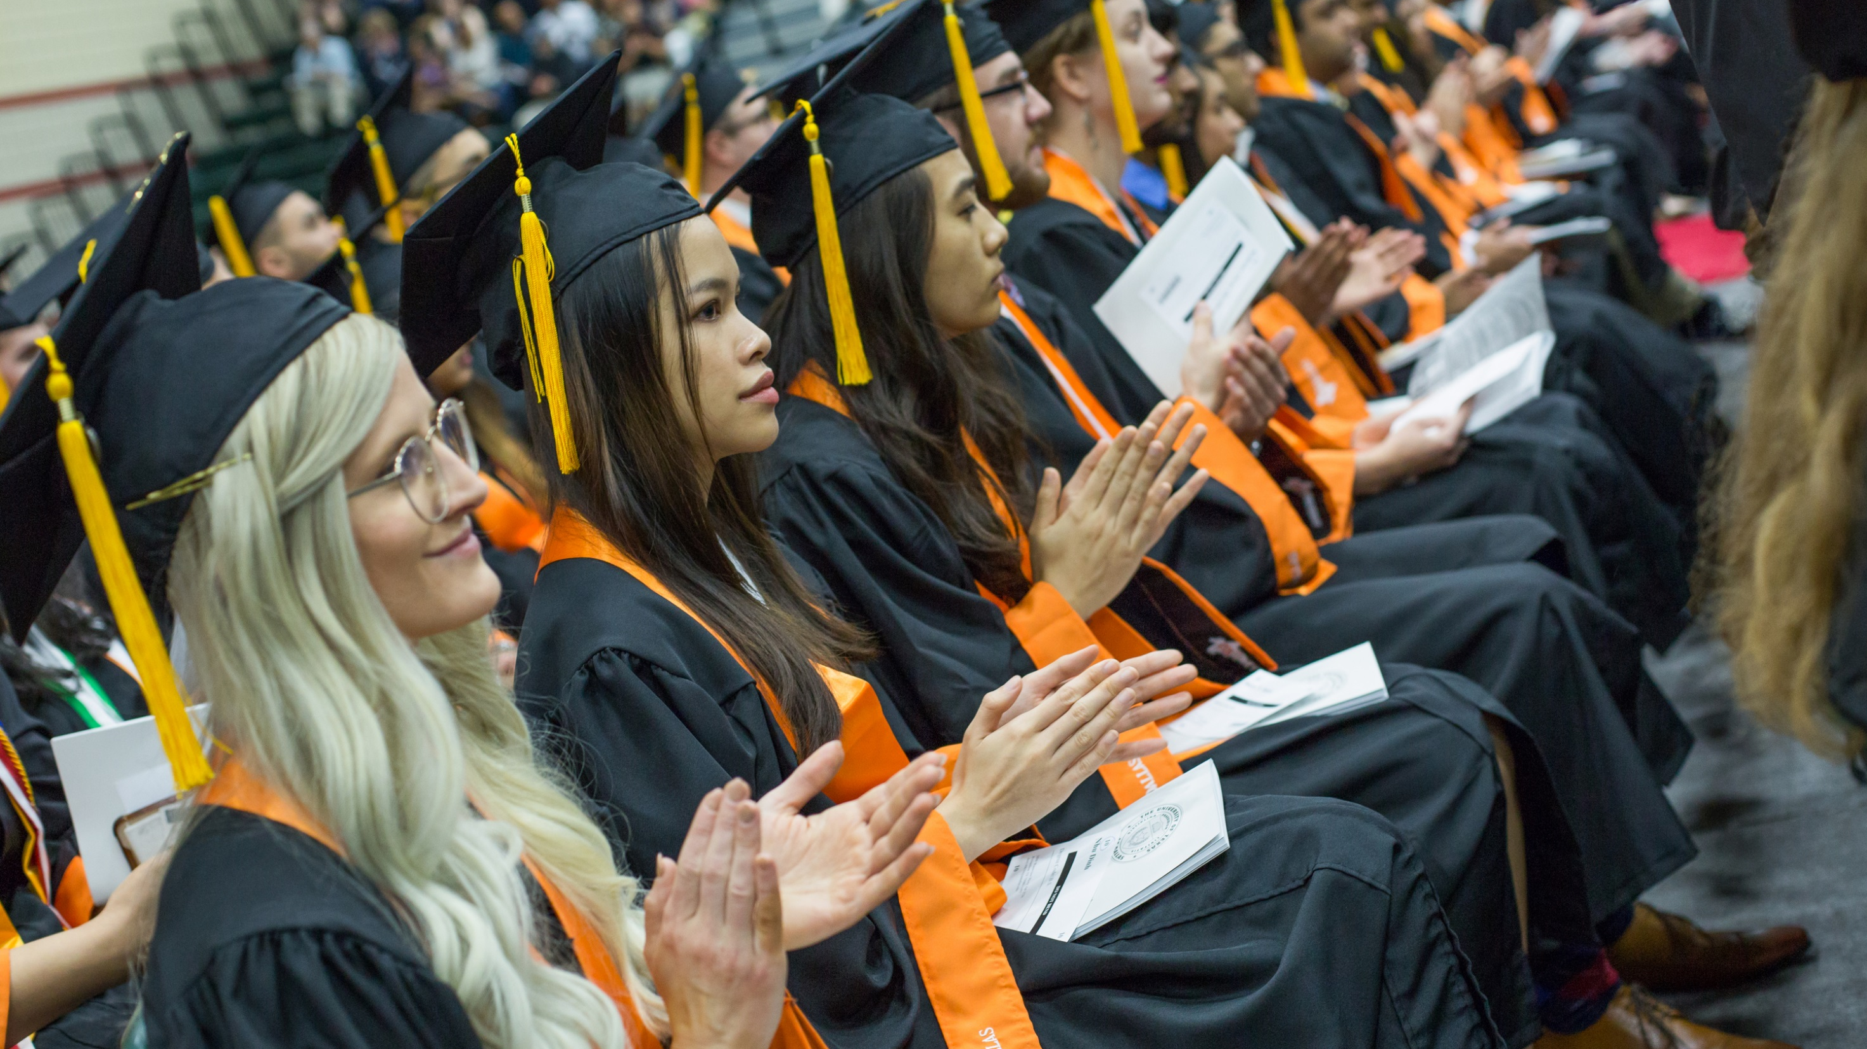
OMGRADUATION
March 27

Slide 5
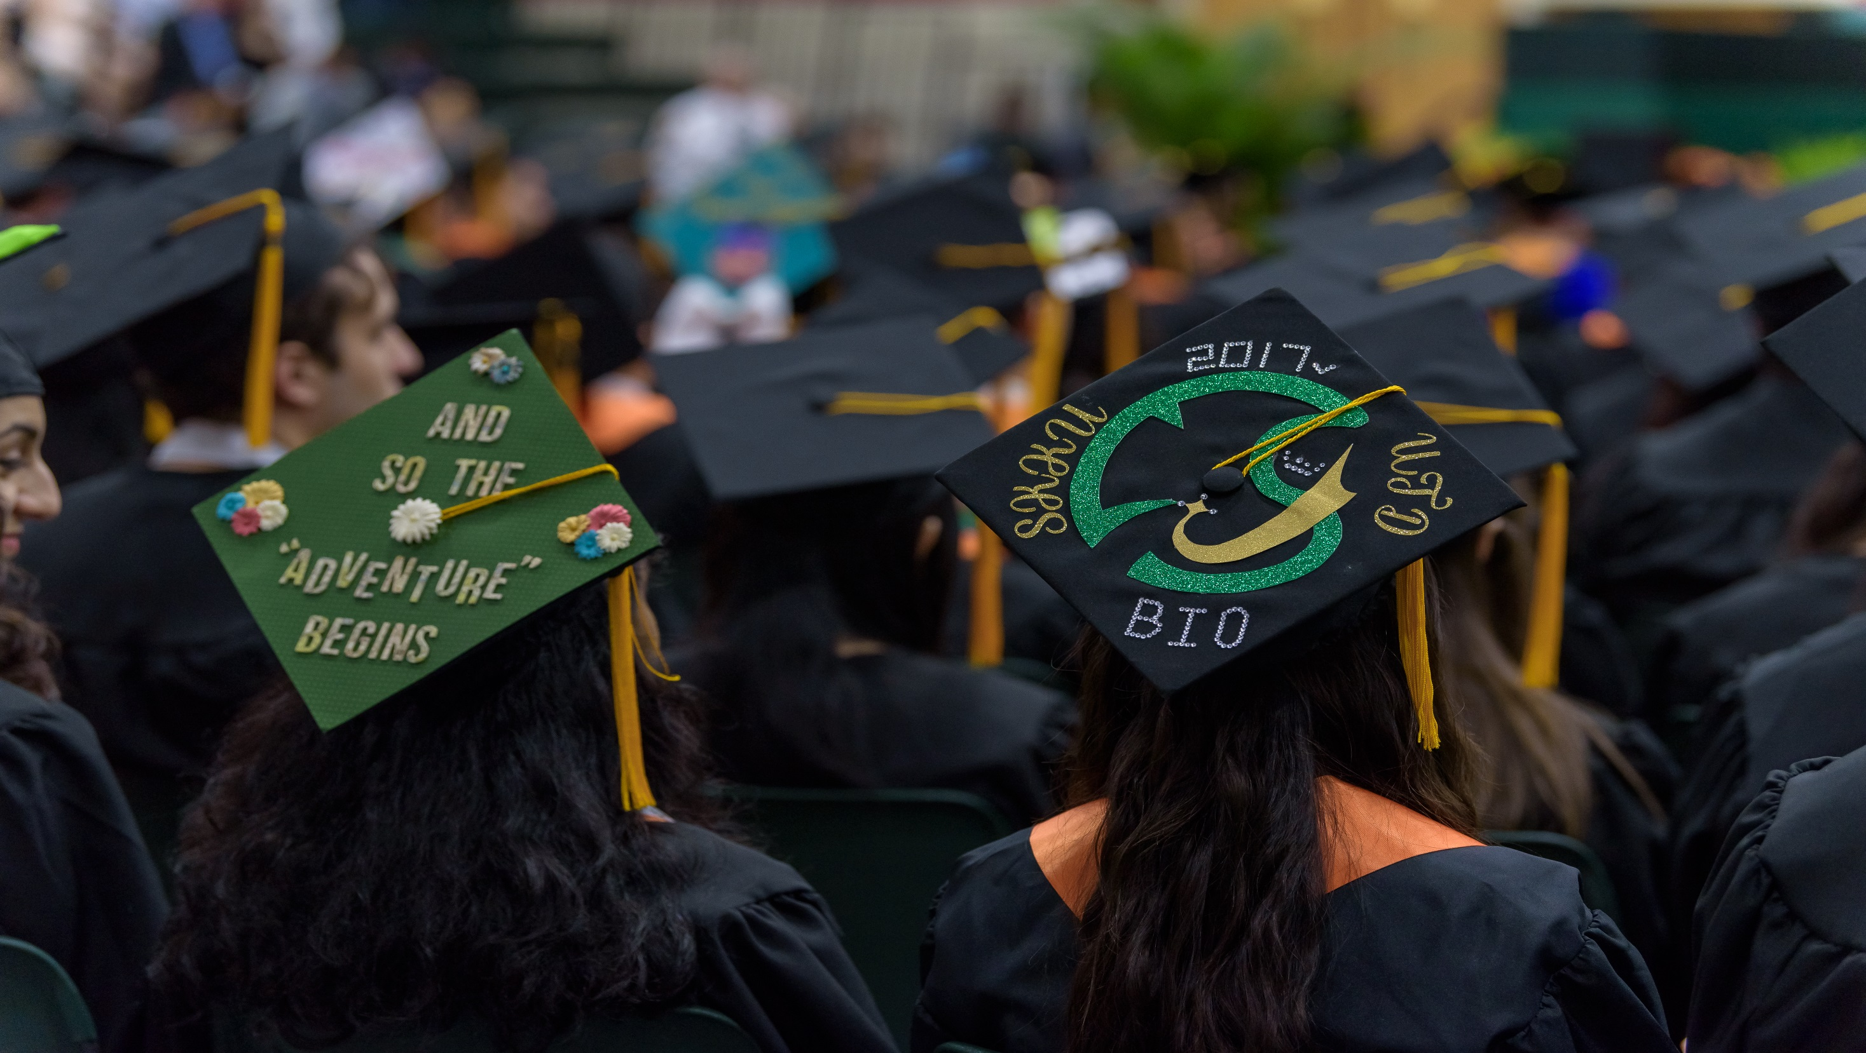
COMET CAP
DECORATING PARTY
April 11

Slide 6
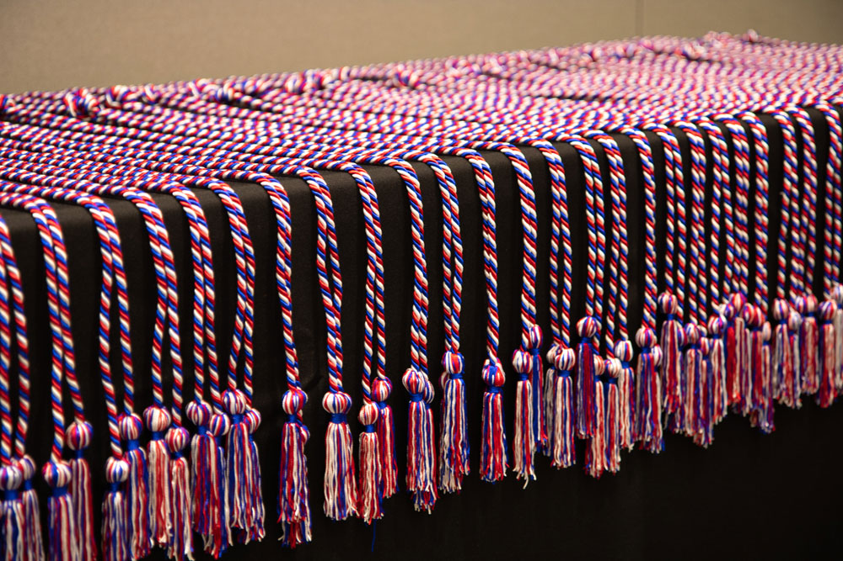
VETERAN GRADUATION
CORD CEREMONY
April 18

Slide 7
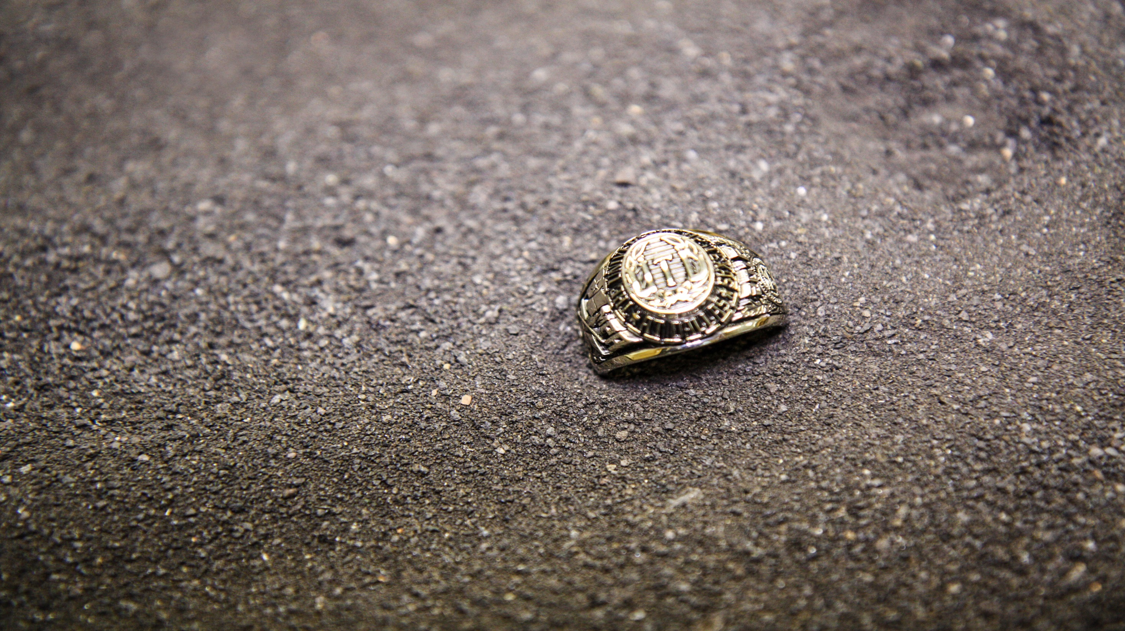
UT DALLAS
RING CEREMONY
April 23

Slide 8
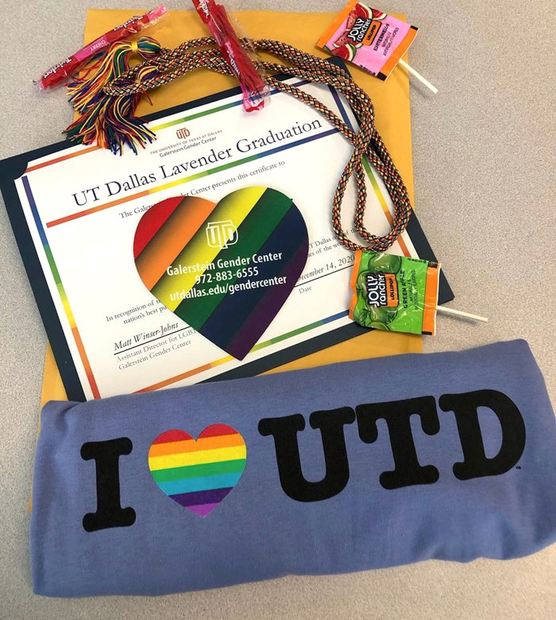
LAVENDER GRADUATION CEREMONY
May 3

Slide 9
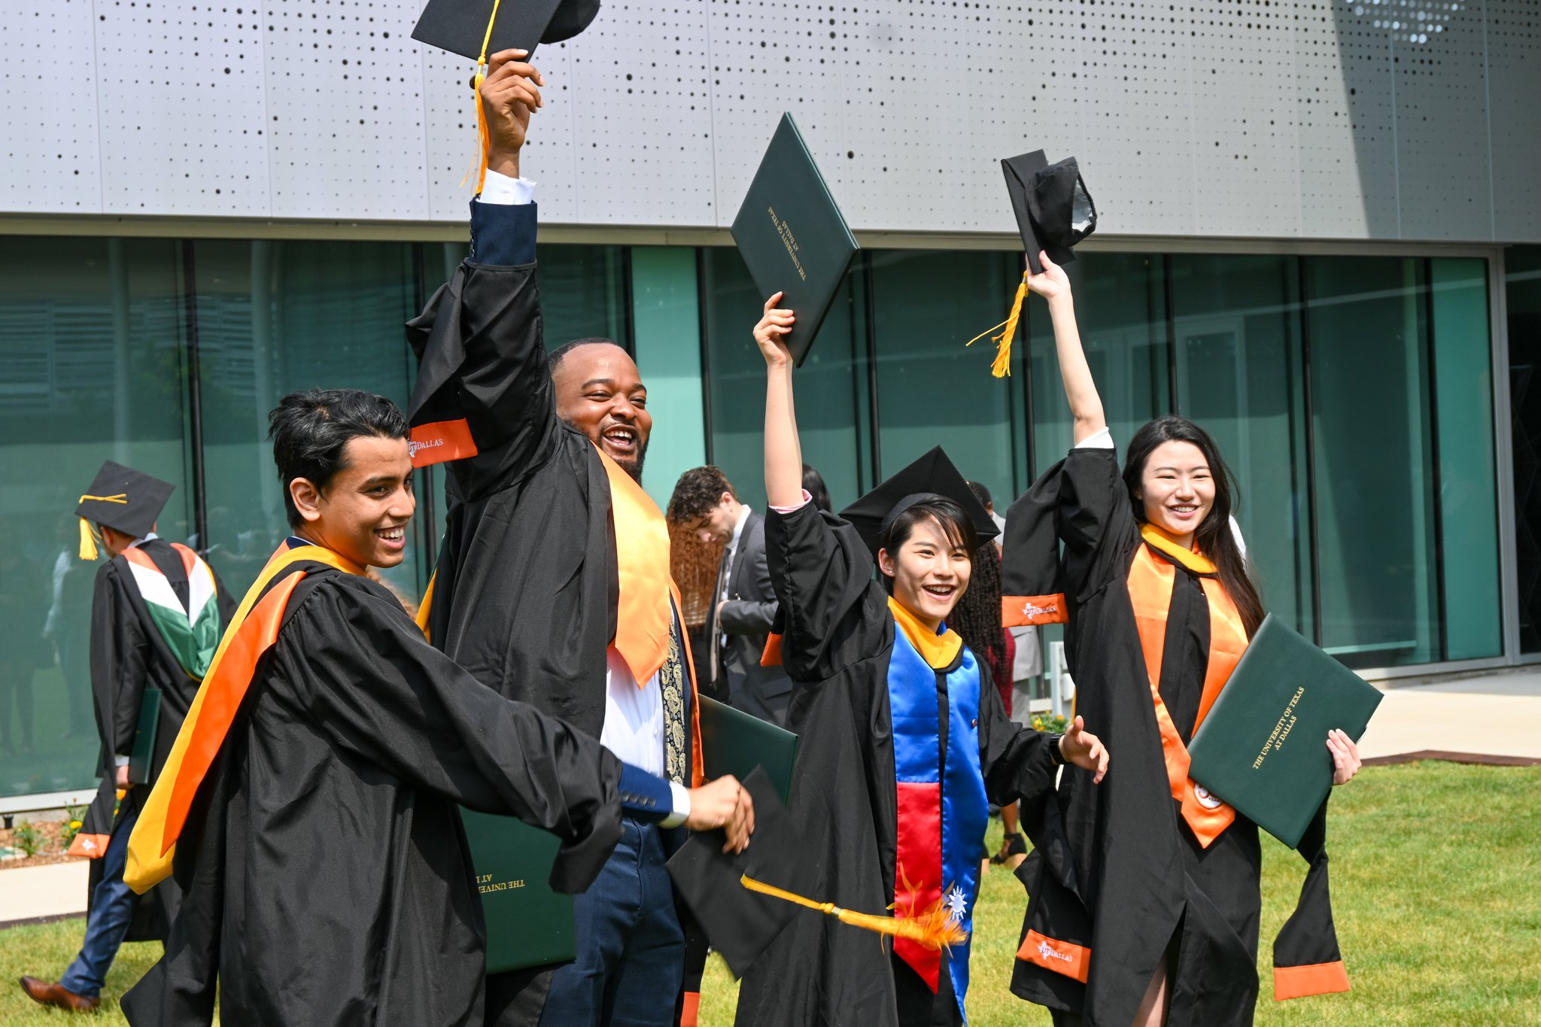
GRADS ON THE GREEN
Following Commencement Ceremonies

Slide 10
GIVE WITH COMET PRIDE
GET YOUR 2024 TEMOC SOCKS TODAY!

Slide 11
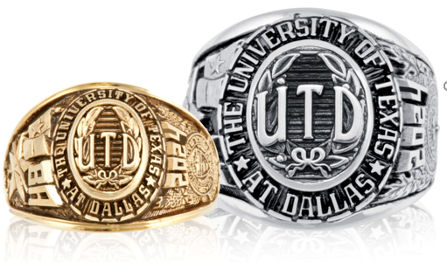
PURCHASE
YOUR
UT DALLAS RING TODAY!

Slide 12
LEAVE YOUR
LEGACY AND
PAY IT FORWARD
PURCHASE A
LEGACY LANE BRICK $50

Slide 13
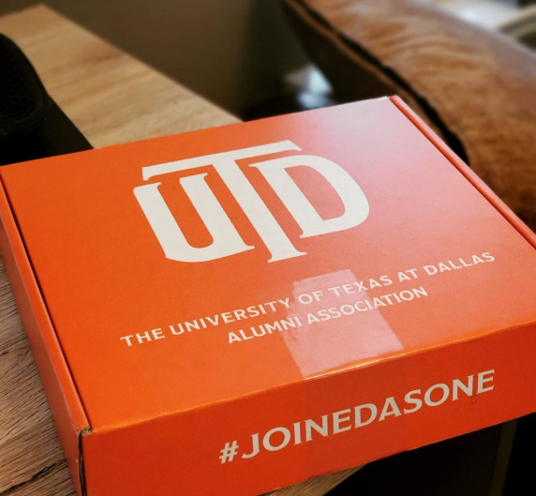
BE A PART OF THE ALUMNI ASSOCIATION
STAY CONNECTED
BE PROUD
SCORE BENEFITS &
LOCAL DISCOUNTS
…AND MORE!

Slide 14
Spring 2024
Commencement
Ceremonies
University Events
February 7, 2024

Slide 15
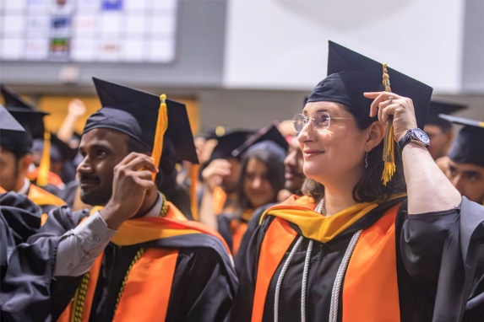
FAQs
University Commencement will honor the spring 2024 class as well as graduates from the preceding fall and summer. This year’s ceremony will be held on Friday, May 10 at 7:30 p.m.
School Commencement Ceremonies will recognize graduates individually as they walk across the stage.
The official schedule of ceremonies with program division for JSOM and ECS will be published in two weeks.
BBS, NSM, JSOM & ECS ceremonies will be held in the Activity Center. BASS, EPPS & IS will be held in the ATC Lecture Hall.
Tickets will be released beginning Monday, April 1.
Visit https://graduation.utdallas.edu/ for more information.

Slide 16
Student Speaker
Applying is Easy!
Step 1: Visit Commencement Student Speaker Application under My Organizations in eLearning
Step 2: Submit these 4 Documents
Application
Your résumé
Script of your proposed speech
Link to a video of you delivering your speech (YouTube and Vimeo work great!)
FAQ’S
All graduating students are eligible to apply
Deadline to apply is March 31
Helpful Pointers
Speeches should be 3-5 minutes in length
Keep it positive and inspirational
Remember your audience! More “we” and less “I”
Not every student is graduating in 4 years and/or is receiving the same degree as you

Slide 17
Graduation Ceremonies May 14 - 17

Slide 18
Graduation Application Deadline:
Priority Deadline: January 24th, 2024
Final Deadline: March 1st,2024

Slide 19
Undergraduate applicants:
You will have your degree plan audited by
the Graduation Team in the Registrar’s Office.
You will receive an email notifying you if you have any deficiencies.

Slide 20
Graduate applicants:
You will have your degree plan audited by the
Office of Graduate Education.

Slide 21
Primary Name Change Deadline for
the Name that will be Printed on
your Diploma:
February 26th, 2024
If you would like to use the Preferred name on
your record, please email Graduation@utdallas.edu
by the deadline above.

Slide 22
Last Day to Remove Confidentiality:
February 26th, 2024
In order for your name to appear in commencement publications,
you must remove or update your confidentiality to partial before the posted deadline.

Slide 23
Last Day to Update RSVP:
March 1st, 2024
You submit your Commencement RSVP at the time you apply for graduation.
To update your RSVP, you must do so through Orion Self
Service by the deadline

Slide 24
Electronic Commencement Guest
Tickets Available:
April 1st, 2024
You will receive an email from MarchingOrder on behalf of UT Dallas Graduation when it is time to claim your guest tickets and GradPass. You will also be prompted to record your name pronunciation for your commencement ceremony. This name pronunciation will be used to create the recording of your name that will be read when you walk the stage at your ceremony.

Slide 25
Outstanding Transcripts and Test
Score Petitions Due:
May 16th, 2024
Transcripts with outstanding transfer credit and test score
petitions must be submitted to the Office of the Registrar

Slide 26
Home Address Change Deadline for
Diploma Mailing:
May 24th, 2024
Diplomas will be mailed to the Home address on file approximately five weeks after commencement. If no diploma address exists, diplomas will be mailed to the ‘Home’ address on file at the time of the diploma order.
All financial holds must be cleared to receive your diploma.

Slide 27
STAY CONNECTED WITH YOUR ALMA MATER
@UTDALLASALUMNI
#UTDGRAD

